Slide 1
Why choose Design Technology?

Slide 2
It is completely different to all other subjects.
You need to think outside the box and be creative.
Design and Technology enables you to work practically with many different tools and materials to create and new product.
You will use the machinery in the workshops, the Pc’s and you’ll draw by hand to create an impressive portfolio

Slide 3
The course
DT is split into 2 sections. 50%Exam and 50%coursework NEA.
The Exam-
All of what you’ve learnt in DT so far will help in your exam.
The is something for everyone in the exam- Multiple choice, Designing, Large mark questions and Evaluations.
The exam is 2 hours long.
Assessed in the Exam are 3 sections-
Core principles
Specialist principles and
Designing/making principles.
The coursework-
The coursework is like a design portfolio.
In the later stages of Y10 the “problem” will be given to the teacher. You have to solve this problem through design ideas, research and models. There is a lot of work that goes into this coursework and you will be working at home.
You will design and make a product​
You will produce a design folder of evidence/written reports/diagrams/designs etc. to accompany your final product.​
The product and folder of evidence will be marked by your teacher and moderated by the exam board.
Example ‘problem’- Design and make a product that encouraged the elderly to exercise outside.

Slide 4
Picking DT will be the perfect subject for you if your thinking of going into one of the following job roles.
Architect
Product Designer
Graphic Designer
3D Cad work
Model Maker
Theatre Set Designer
Carpenter
Interior Designer
Design For Industry
Cabinet Maker
Media Specialist
Cabinet Maker
Fashion industry
Teaching
Transport Design
The list goes on…

Slide 5
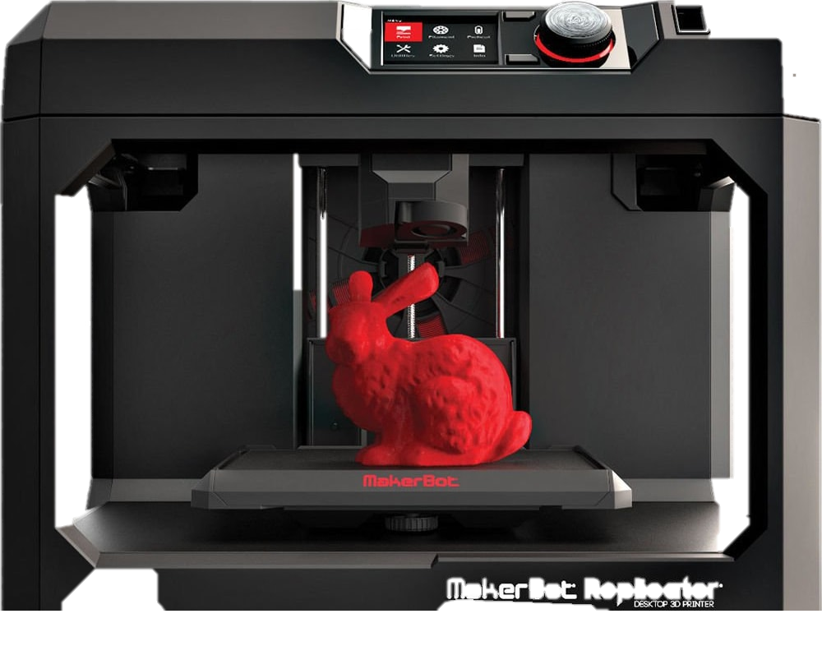
What skills will I learn?
In year10 you will do a lot of theory work which will help you in your exam. You will also learn onshape which is a programme to design on the pc that then can be printed out on the 3D Printers.
You will learn the following skills
Time Management.
Creativity
Problem-Solving
Planning
Evaluating
Communication
Self- Reflection
And many more…

Slide 6
What will I be able to use?
The laser Cutter
The 3D Printer
The Sewing Machines
The lathe
The Hand Tools
The Braising Hearth
The Vacuum former
The strip heater
The Scroll Saws
To name just a few…

Slide 7
So make the right choice!

